Slide 1
Week 23-24
Nips2023

Slide 2
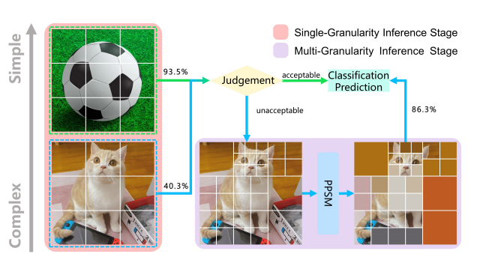
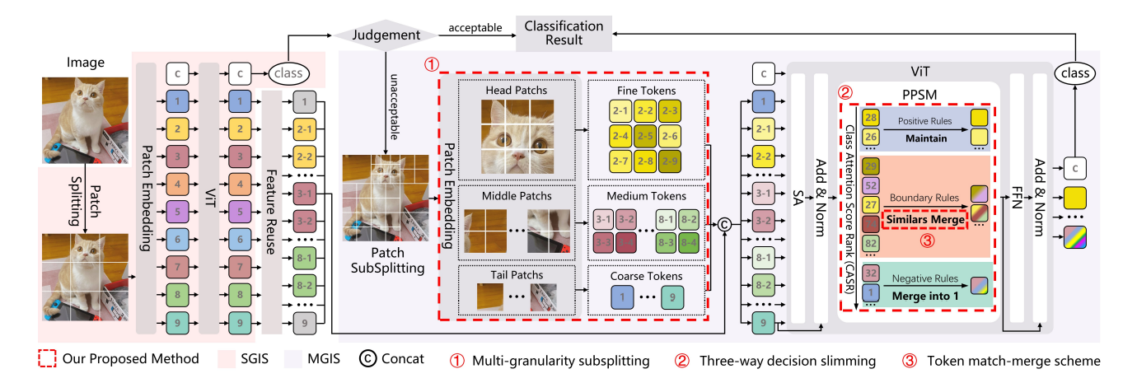
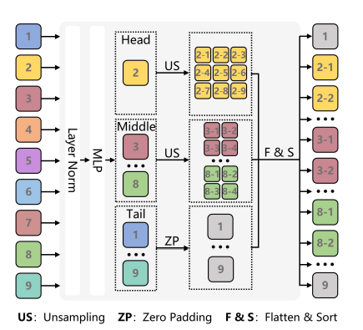
MG-ViT: A Multi-Granularity Method for Compact and Efficient Vision Transformers

